Slide 1
Advanced Vocational Training in Standardisation Related Issues: Raising Professional Qualification of Specialists in Russia and NIS
Galina PANKINA
The Academy for Standardisation, Metrology and Certification
Russia

Slide 2
Special Professional Re-Training Programmes
Professional re-training aims meeting educational needs of people and supporting their professional development. It provides for raising qualification in accordance with changing job requirements and social conditions.
Federal Act “On Education in the Russian Federation”, 2013
Standardisation is a dynamic and rapidly developing area; experts need to improve their qualifications continually.

Slide 3
Professional Training and Re-Training Needs
STANDARDS
BUSINESS
UNIVERSITIES
RESEARCH INSTITUTES
GOVERNMENT
NGOs
MEDIA
ROSSTANDART

Slide 4
Training Levels
EXPERT in International Standardisation
BACHELOR
Degree in Technical or Economic Subjects
MASTER/ SPECIALIST
Degree in Technical or Economic Subjects
EXPERT in Standardisation
PhD
Degree in Technical or Economic Subjects
ENGINEER in Standardisation

Slide 5
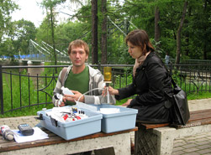
The Academy for Standardisation, Metrology and Certification
ASMC is the official educational establishment of the National Standardisation body – Rosstandart.
ASMC runs professional re-training (upgrading) courses and practical projects in standardisation, metrology and certification and promotes ISO standards in Russia.
ASMC has branches in key regions of Russia, and delivers courses to practitioners, researches and university teachers.
ASMC actively participates in activities ISO/TC 232 Learning services outside formal education.
ASMC is a member of several National Technical Committees developing Russian standards harmonised with ISO standards.

Slide 6
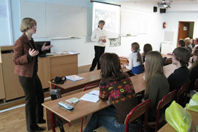
The Academy for Standardisation, Metrology and Certification
Analyses training needs at the national and regional levels.
Runs professional retraining courses (72-1000 hours) on such issues as:
Standardisation
Quality Management
Environmental Management
Energy Management
Risk management
Technical regulation
Metrology
Certification
Accreditation
Publishes “Competency” journal which is included in the list of recognised research journals of Russia.

Slide 7
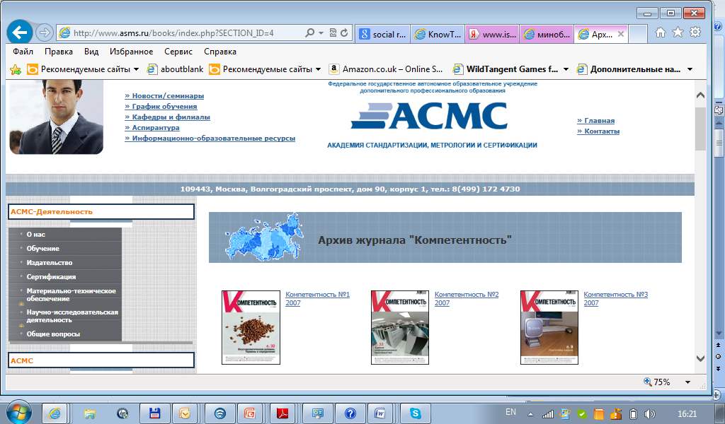
ASMC WEB RESOURCES

Slide 8
Priority Training Courses Russia and NIS, 2011-2013
Businesses aiming to enhance their competitiveness, efficiency and effectiveness require personnel trained in:
ISO 9000 Quality Management
ISO 14000 Environmental Management
ISO 50001 Energy Management
ISO 31000 Risk management
ISO 26000 Social Responsibility
OHSAS 18000 Occupational Health and Safety Assurance
UNE-CEN/TS 16555 Innovation Management
Plan
Do
Check
Act

Slide 9
Providing Standardisation Engineers and Experts for Russia, Customs Union and NIS
Annual Performance of the Academy for Standardisation, Metrology and Certification
Meeting needs of Russia
5000-7000 trainees in standardisation related issues
12000-15000 trainees in metrology related issues
Meeting needs of Customs Union and NIS in standardisation, metrology and certification experts
Over 1500 trainees for the Customs Union (Russia, Kazakhstan, Belorussia)
About 100 trainees for NIS (Armenia, Azerbaijan, Tajikistan, Turkmenistan, Uzbekistan, etc.)
When necessary ASMC covers costs of trainees coming from NIS

Slide 10
Conclusions
Standardisation, Metrology and Certification issues have been present in Russian university curricula since many decades ago.
Technical universities lead in training bachelors and masters in Standardisation and Metrology.
Curriculum for training economists does not contain compulsory standardisation related courses, though management related courses may cover these issues.
Professional re-training establishments help to fill gaps in higher school curricula and to meet changing job requirements by means of developing and continually improving numerous standardisation related courses.
ISO standards form a core for most standardisation related training programmes in Russia.
Professional re-training establishments are Involved in the activities of National Technical Committees and participate in various projects aimed at wider promotion of ISO projects in Russia and NIS.

Slide 11
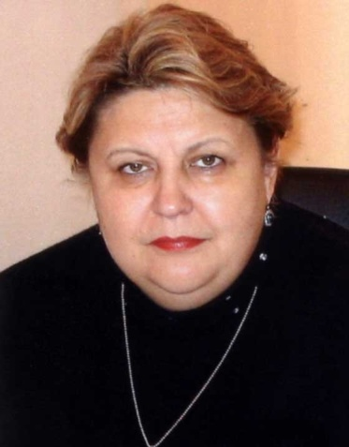
Thank you!
Galina V. Pankina
Rector of the Academy for Standardisation, Metrology and Certification
Doctor of Science
Professor
www.asms.ru pankinagv@asms.ru

