Slide 1
Social Responsibility: Training Students and Working with Business in Russia
ISO General Assembly
Open Session on Education
Tatiana Guseva
D. Mendeleyev University
19.09.2013 Saint-Petersburg

Slide 2
Social Responsibility
responsibility of an organisation for the impacts of its decisions and activities on society and the environment through transparent and ethical behaviour that
contributes to sustainable development , including health and the welfare of society;
takes into account the expectations of stakeholders;
is in compliance with applicable law and consistent with international norms of behaviour;
and is integrated throughout the organisation and practised in its relationships

Slide 3
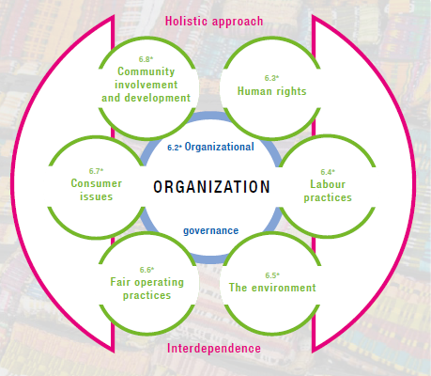
ISO 26000: Core Subjects of Social Responsibility

Slide 4
Social Responsibility Advantages
Competitive advantage
Reputation
Ability to attract and retain workers or members,
customers, clients or users
Maintenance of employees’ commitment and productivity
View of investors, owners, donors, sponsors and the financial community
Relationship with companies, governments, media, suppliers, peers, customers and the community

Slide 5
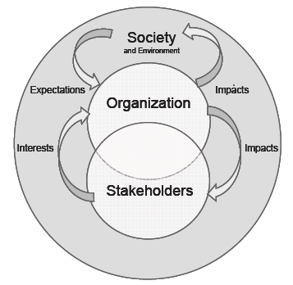
Academia and SR
Universities and research centres can and should significantly contribute towards:
assessing expectations;
evaluating impacts;
developing measures to minimise negative impacts;
Improving labour practices;
…..

Slide 6
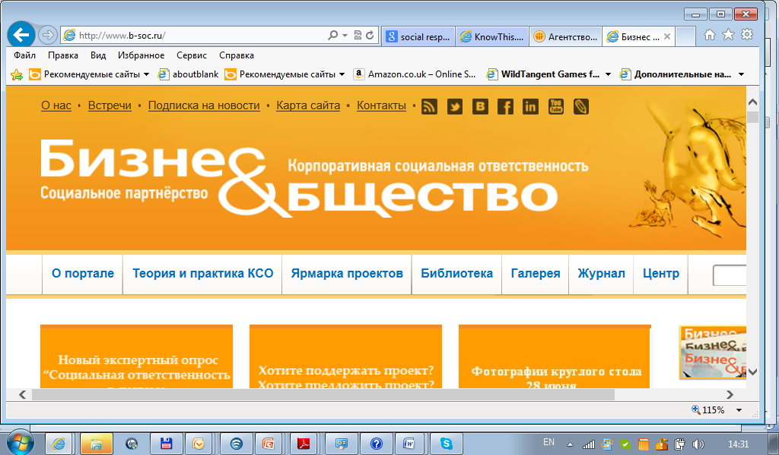
Why Academia is interested in SR?
Training professionals for business and government
Developing and testing new research methodologies
Being/becoming socially responsible organisations
Improving sustainability of higher school establishments
Promoting socially responsible behaviour in business community
Attracting partners, donors, sponsors
…
…

Slide 7
SR and Open Reporting
Training
A special “Social Responsibility” course
A part of “Marketing Communications” course
Frequent topic for Bachelor/Master Dissertations of students majoring in Management and Marketing
Universities are involved in:
Discussing performance indicators and draft reports
Checking and verifying Open Reports

Slide 8
SR and Environment
Training:
General and special courses, often focused on specific industry related environmental problems
Research
New methodologies for EIA, environmental auditing, EHS performance assessment, etc.
Development of practical pollution prevention and control solutions
Saint-Petersburg Water Utility

Slide 9
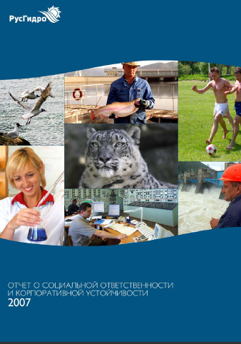
Building relationships with business
RusHydro collaborates with the Siberian University, Moscow Construction University, Saint-Petersburg Polytechnic University:
Supporting research projects
Running practical training (job placement) programme
Working with local primary and secondary schools
Awarding scholarships and special prizes to students
RusHydro Energy Company

Slide 10
SR helps to promote ISO standards
To move towards Social Responsibility, an organisation should understand an use in practice international standards:
ISO 9000
ISO 14000
ISO 31000
ISO 50001
Specific sector oriented standards

Slide 11
Conclusions
The essential characteristic of SR is the willingness of an organisation to incorporate social and environmental considerations in its decision making and be accountable for the impacts of its decisions and activities on society and the environment.
SR opens enormous opportunities to Academia, which can and should become socially responsible itself and widely promote SR.
Universities and research centres contribute towards ISO 26000 promotion by means of training and research and do their best to use their influence in Russia and NIS.
Academic institutions focus on SR aspects in accordance with their specialisation and collaborate with each other to achieve synergy and better impacts.

Slide 12
Thank you for your attention!
www.muctr.ru
www.14000.ru
tguseva@muctr.ru

